Slide 1

Gold Price Prediction Using Time Series Forecasting
NIRVA PATEL : 202201071
RIDDHI MISTRY: 202201238
Dataset - Link

Slide 2
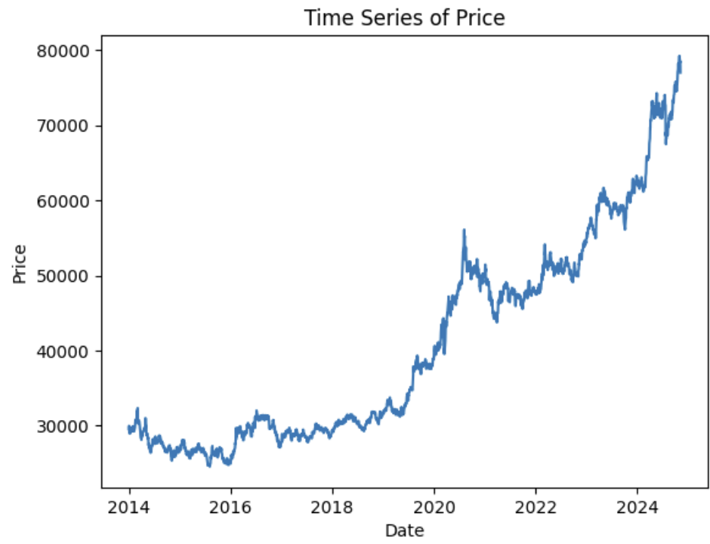
Dataset Overview
The dataset contains daily gold price data. It spans from 2014 to 2024 with 2,806 entries.
Columns in the Dataset: Date, Price, Open, High, Low, Change
Observations: The dataset has no missing values. The gold price shows a steady upward trend over the years, with some fluctuations.

Slide 3
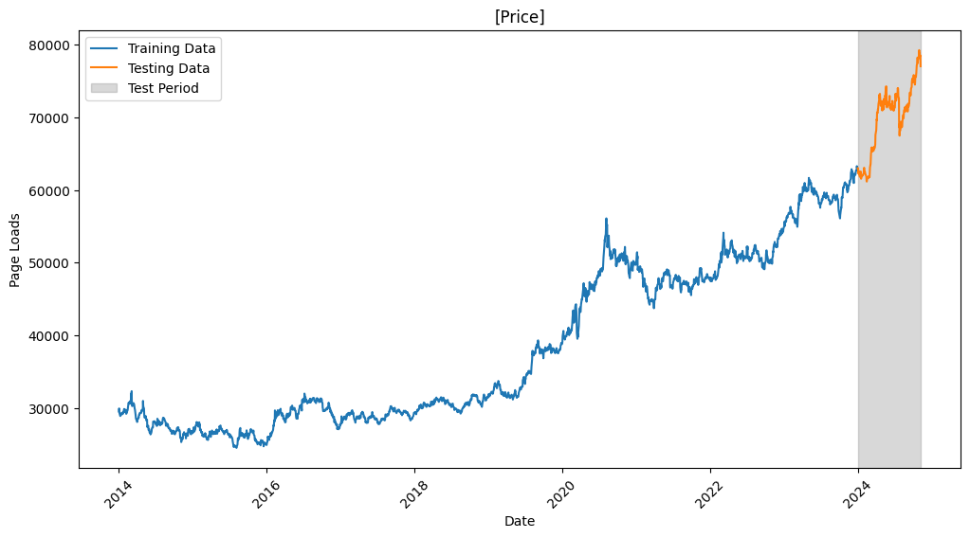
Split Data into Training and Test Data

Slide 4
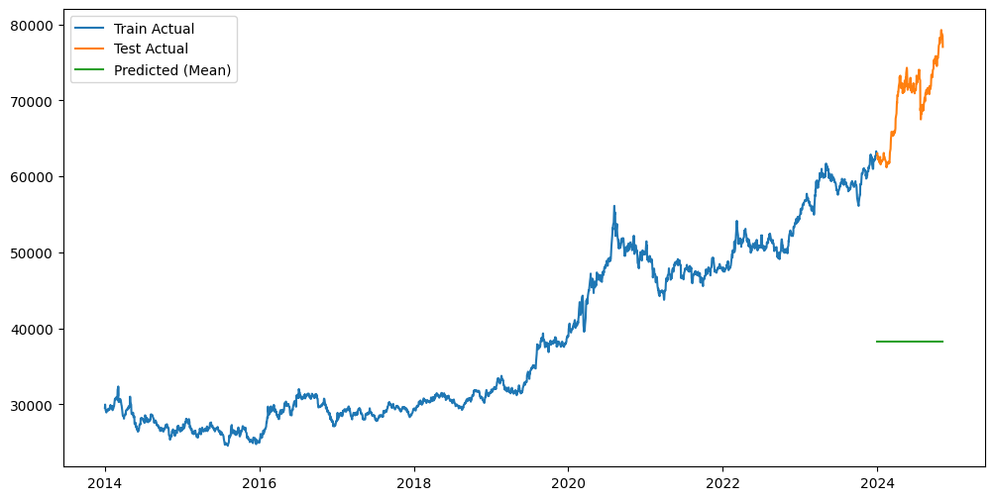
Evalution of Base Line Model
1. Mean
RMSE- 31,979.19

Slide 5
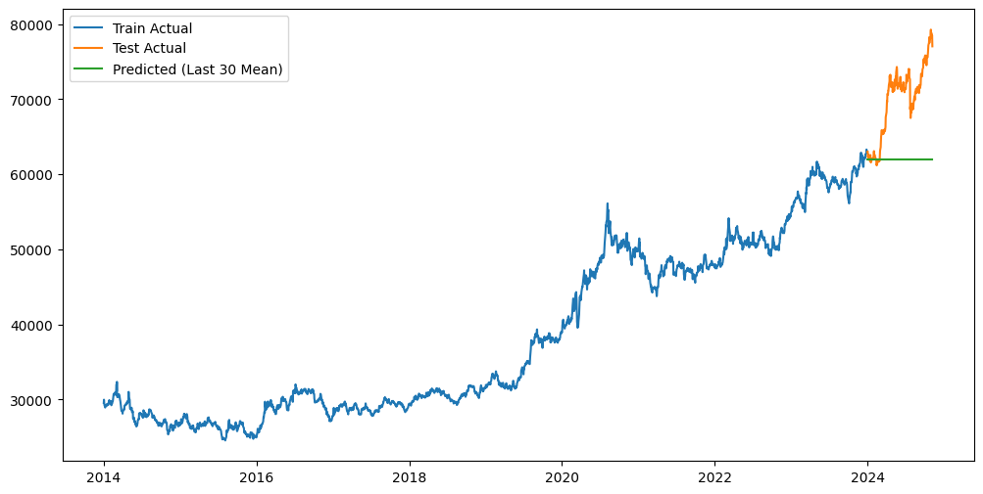
Evalution of Base Line Model
2. Mean of Last 30
RMSE- 9220.307918

Slide 6
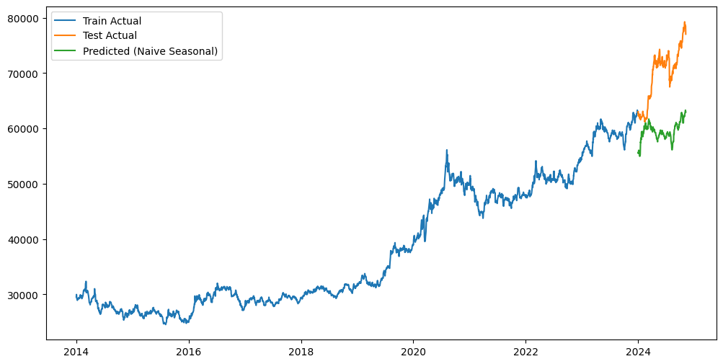
Evalution of Base Line Model
3. Naive Seasonal
RMSE- 11,270.45

Slide 7
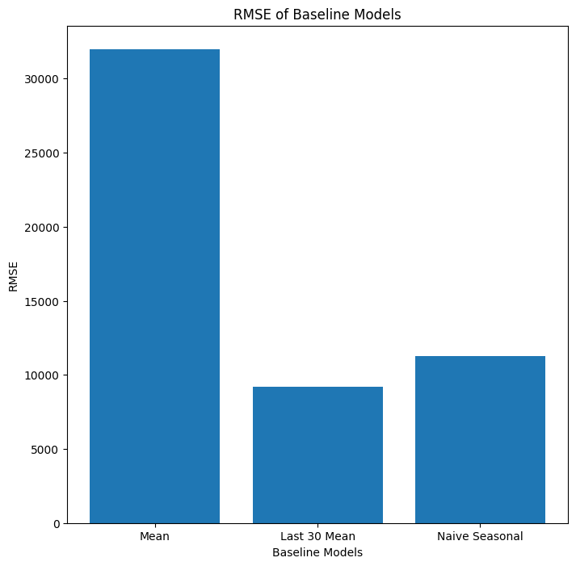
Evalution of Base Line Model

Slide 8
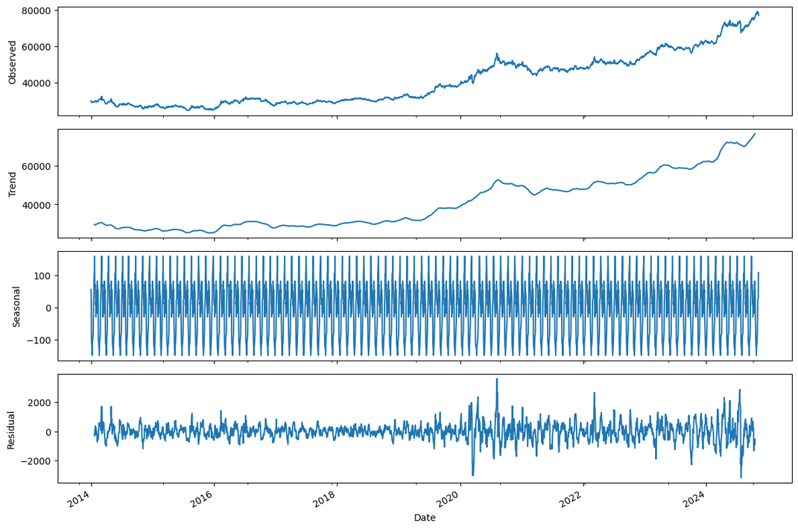
Time Series Breakdown (Decomposition)
01
02
Observed Series
Trend
The actual gold price over time.
Shows the overall direction — prices are going up
03
04
Seasonality
Residual
Repeating patterns (like monthly)
The leftover noise or random changes.

Slide 9
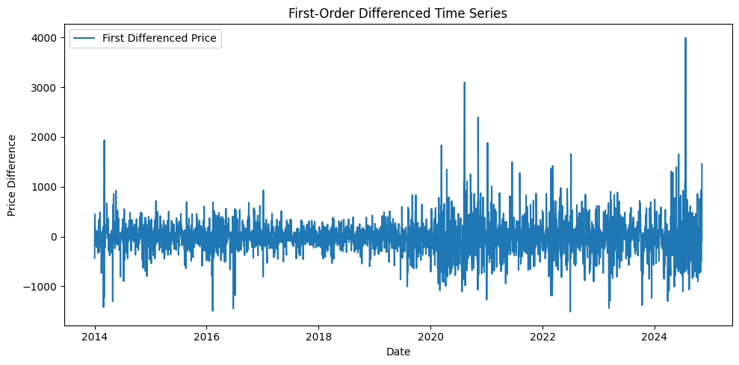
Understanding Stationarity in Time Series
Why is Stationarity Needed for Time Series?
Because statistical models work best when the data doesn’t change too much over time. Stationarity means the data has a constant mean, variance, and pattern — this helps the model make better, stable predictions.

Slide 10
ADF Test
The ADF test is used to check whether a time series is stationary or not, based on this Hypothesis
ADF Test Hypotheses:
Null Hypothesis (H0): The series has a unit root
Alternative Hypothesis (H1): The series does not have a unit root
p-value < 0.05: Reject the null hypothesis (H0)
p-value ≥ 0.05: Fail to reject the null hypothesis (H0)
A significance level of 0.05 means there is a 5% chance that you might incorrectly reject the null hypothesis

Slide 11
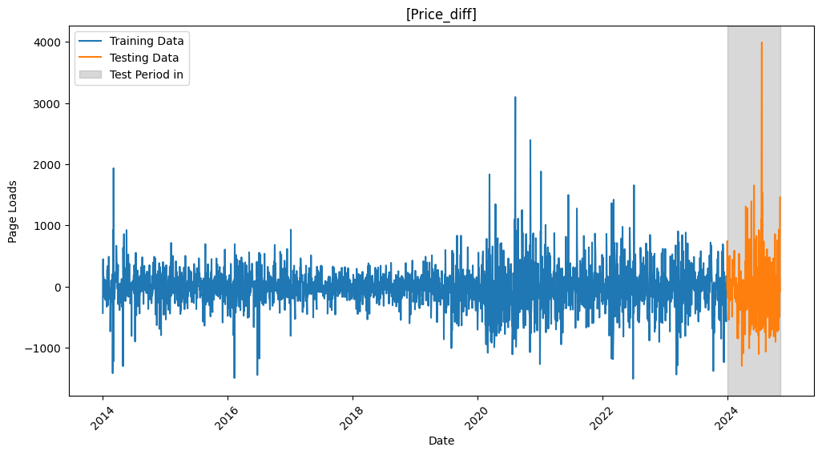
Split Stationary Data into Training and Test Data

Slide 12
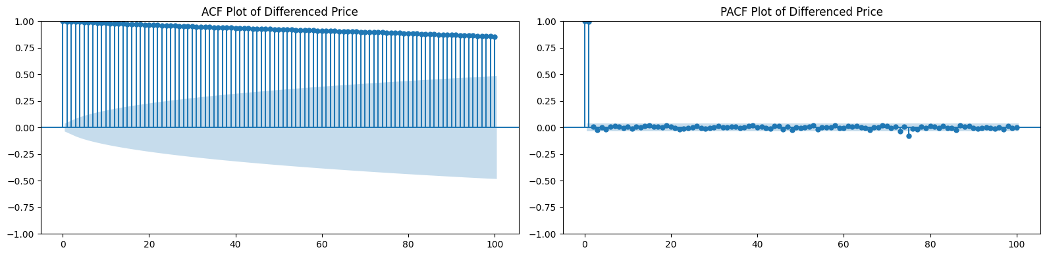
ACF and PACF Plot
ACF showed a slow decay.
The PACF cuts off after lag 2, suggesting an AR(2) process

Slide 13
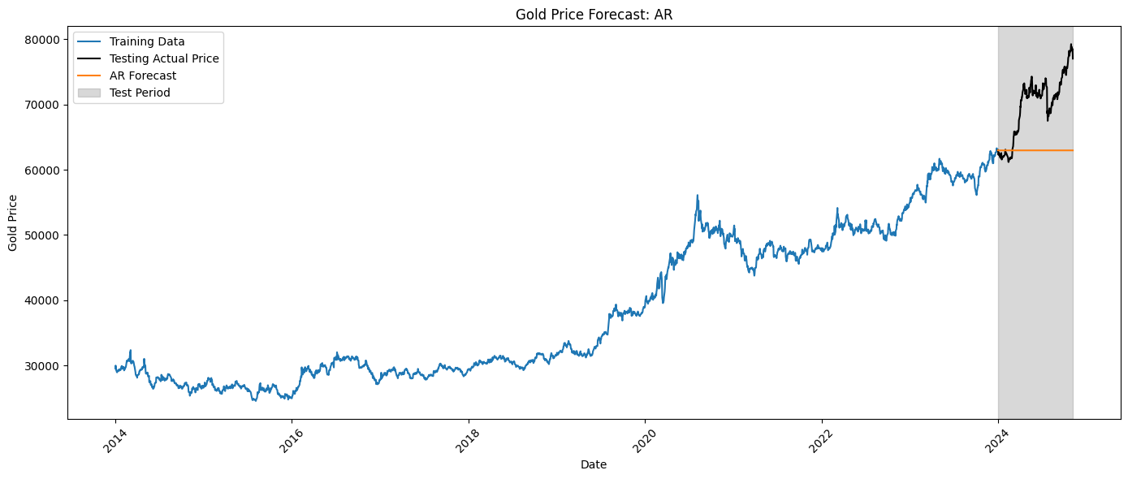
AR Model
AR(2) Model
Yt​=C+ϕ1​Yt−1​+ϕ2​Yt−2​+ϵt​
RMSE: 8405.498547

Slide 14

MA Model
MA(2) Model
Yt​=μ+θ1​ϵt−1​+θ2​ϵt−2​+ϵt​
RMSE: 8405.100736

Slide 15

ARMA Model
ARMA(4,4) Model
Yt​ = C+ ϕ1​Yt−1 ​+ ϕ2​Yt−2 + ϕ13Yt−3 ​+ ϕ4​Yt−4 ​​ + μ + θ1​ϵt−1​ + θ2​ϵt−2​ + θ3​ϵt−3 + θ4​ϵt−4​ + ϵt​
RMSE:8407.455215

Slide 16
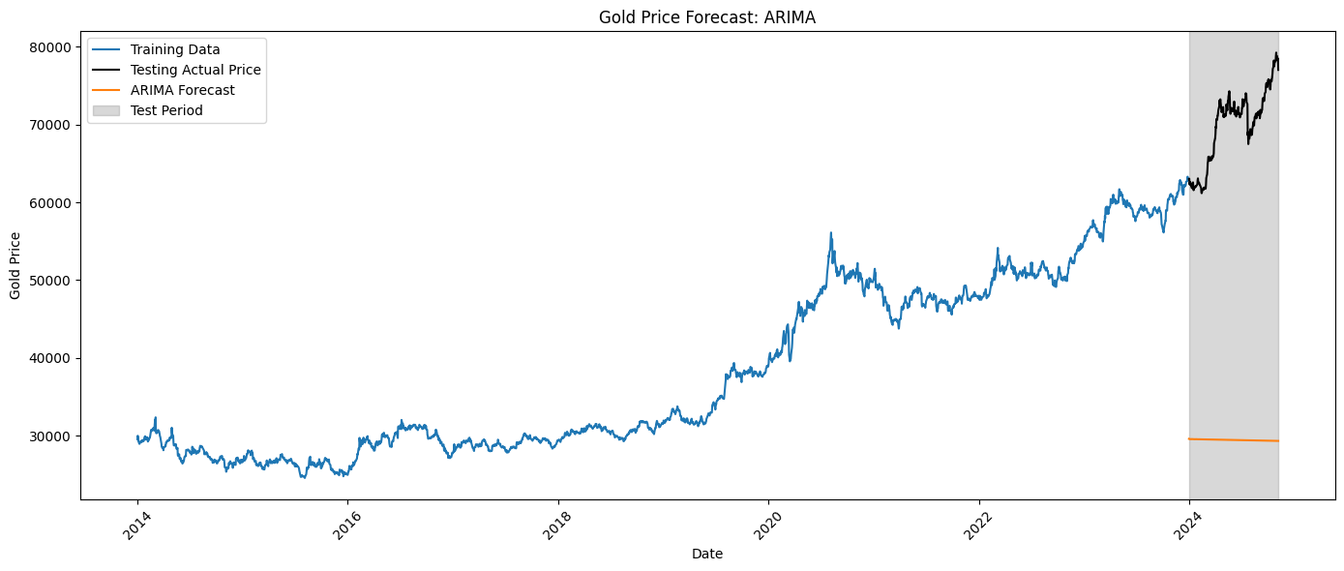
ARIMA Model
ARIMA(4,1,4) Model
ΔYt​=C + ϕ1​ΔYt−1 ​+ ϕ2​ΔYt−2​ + ϕ3​ΔYt−3​ + ϕ4​ΔYt−4​ + μ+θ1​ϵt−1 ​+ θ2​ϵt−2​ + θ3​ϵt−3​ + θ4​ϵt−4​ + ϵ
RMSE: 40703.601935

Slide 17

SARIMA Model
SARIMA(1,1,0)(1,1,1)30 Model
RMSE: 41866.452982

Slide 18
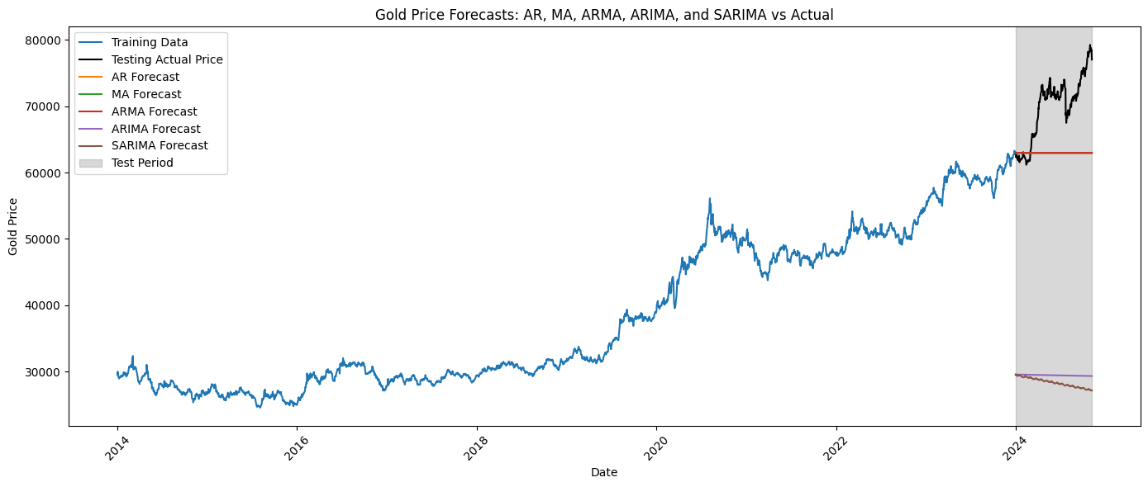
Evalution of All Statistical Models

Slide 19
Why RMSE for model Evaluation?
RMSE measures how far the model's predictions are from the actual values. It penalizes larger errors more due to the squaring of differences. A lower RMSE means the model's predictions are closer to the true value
Why do AR, MA, and ARMA models perform better than ARIMA and SARIMA?
AR, MA, and ARMA work better because the data has short-term patterns. ARIMA and SARIMA have more parameters, and without proper tuning, they overfit.

Slide 20
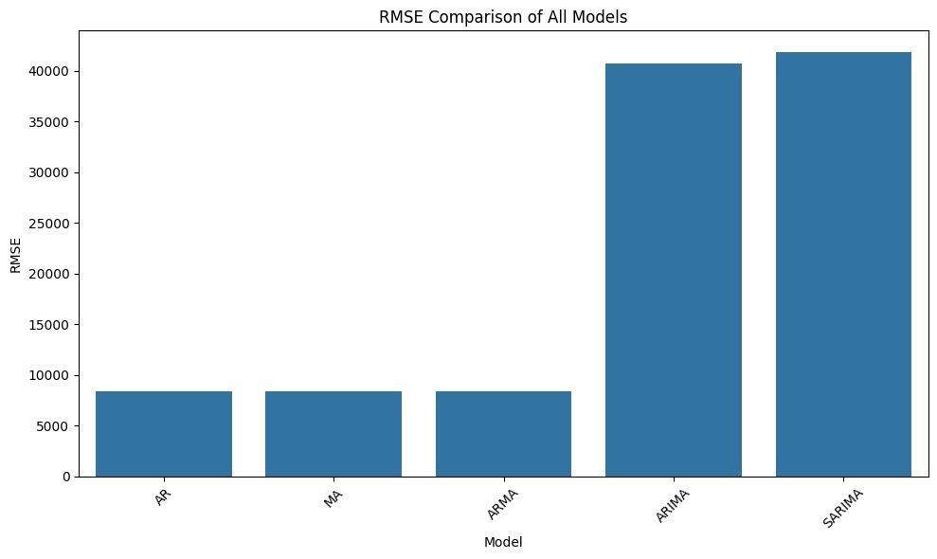
Evalution of Stationary Models

Slide 21
Limitations of Statistical Models
Assume errors are IID (independent and random)
Only work with linear relationships
Data must be stationary to make good predictions
Can’t handle complex or non-linear patterns

Slide 22
(Recurrent Neural Network) RNN
A recurrent neural network (RNN) is a type of neural network designed for processing sequential data, like time series.
It retains information from earlier inputs by maintaining a form of memory, which it uses to influence future predictions or outputs.

Slide 23
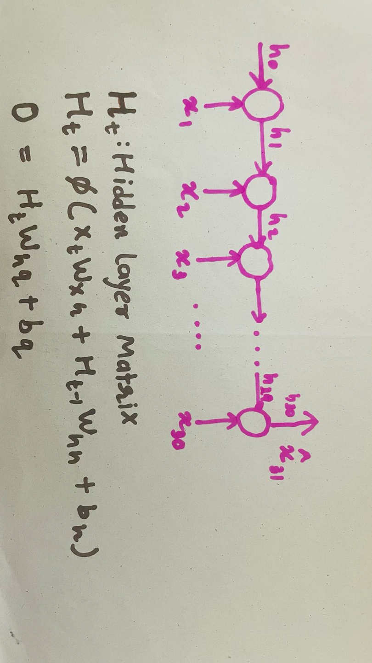
Structure of RNN

Slide 24
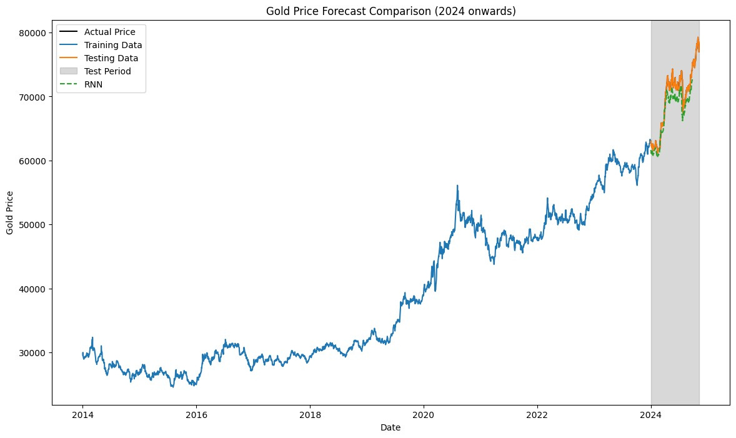
Recurrent Neural Network (RNN)
RMSE - 1,815.9048

Slide 25
Limitations
• Vanishing/Exploding Gradient Problem: During training, gradients can become very small and while backpropagating, the gradient values becomes nearly zero, which leads to improper weights.
• Short-Term Memory: RNNs struggle to retain information from earlier time steps in long sequences, making it hard to capture long-term dependencies.
• Difficulty Handling Long Sequences: As sequences get longer, performance often degrades because the network can’t remember early inputs well.

Slide 26
Long Short Term Memory (LSTM)
A special type of neural network capable of learning long-term dependencies by using memory cells and gates to control the flow of information.

Slide 27
Gates in LSTM:
• Forget Gate: Decides what information from the
previous cell state should be discarded.
• Input Gate: Determines which new information should
be added to the cell state.
• Output Gate: Controls what information is sent as output
from the current cell state.

Slide 28
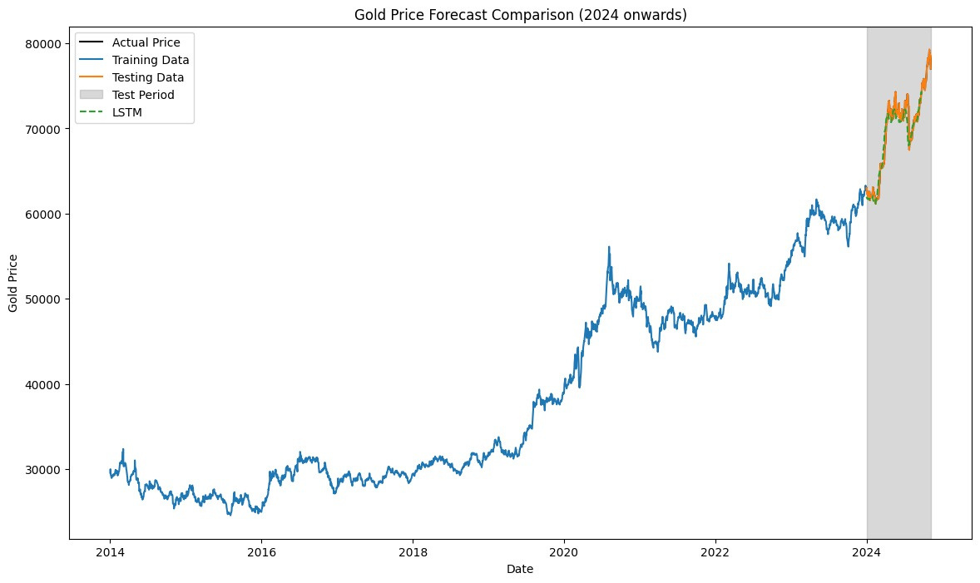
Long Short Term Memory (LSTM)
RMSE- 1,222.5227

Slide 29
Grated Recurrent Unit(GRU)
A simplified version of LSTM that is computationally efficient while still capturing long-term dependencies.

Slide 30
Gates in GRU:
• Update Gate:
(Forget Gate + Input Gate) of LSTM
Controls how much of the past value to be retained, and how much new information should be added
• Reset Gate: Controls how much information to "reset" or change in the current state.

Slide 31

Grated Recurrent Unit(GRU)
RMSE- 780.605

Slide 32
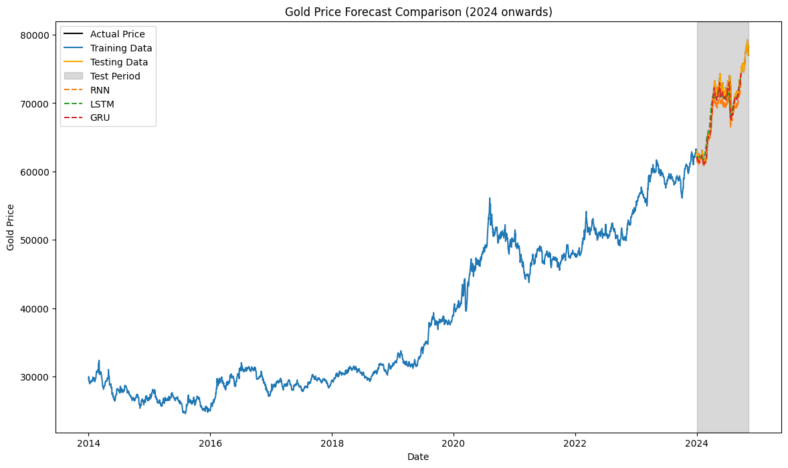
Evalution of Deep Learning Models

Slide 33
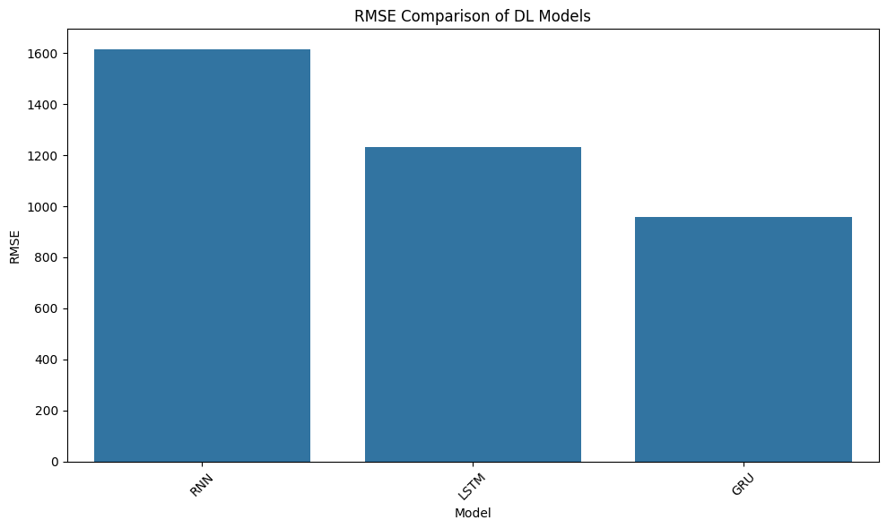
Evalution of Deep Learning Models

Slide 34
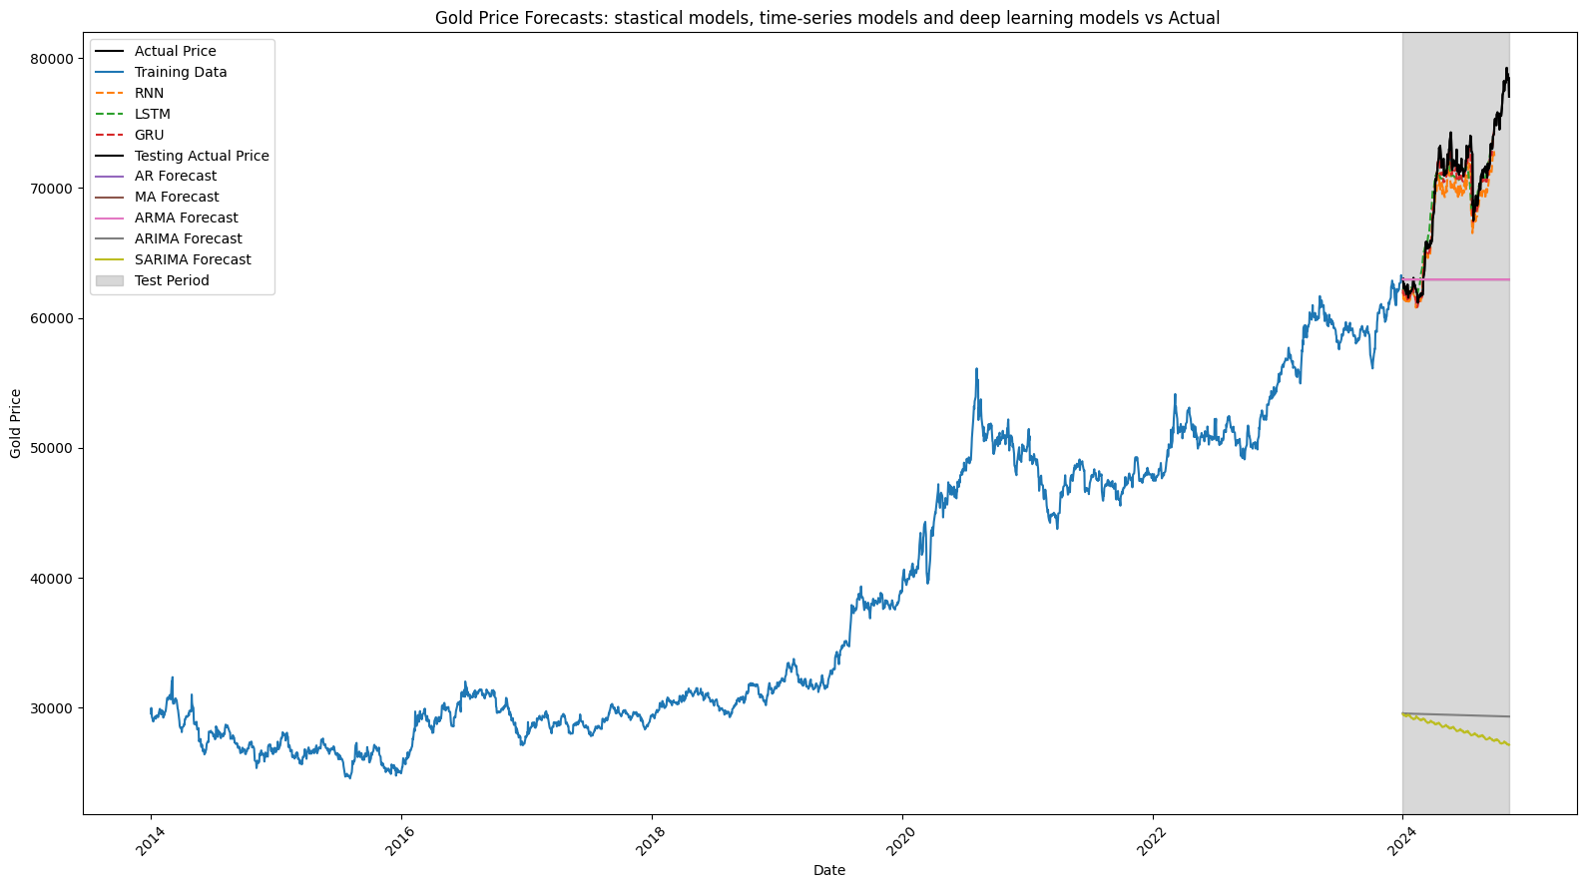
Evalution of All Models

Slide 35
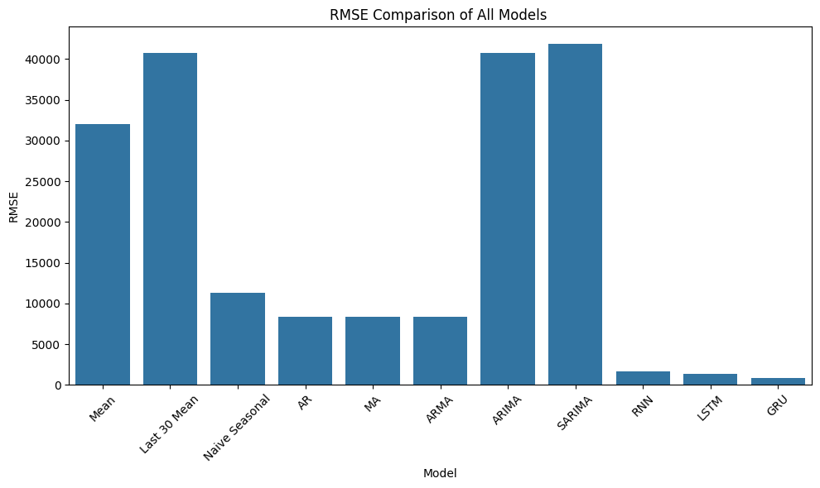
Evalution of All Models

Slide 36
Final Conclusion
Deep learning models like RNN, LSTM, and GRU performed the best with the lowest RMSE, making them the most accurate for forecasting.
Traditional models like AR, MA, and ARMA showed moderate performance, while ARIMA and SARIMA had the highest RMSE, indicating poor accuracy on this dataset.
Therefore, GRU is the best choice for future predictions in this case.

Slide 37
Thank You

